Slide 1
Chapter 13: I/O Systems
Main jobs of computer
  I/O and processing
In many cases the main job is I/O.
Role of operating system
  Manage I/O operations and I/O devices.
In this chapter we bring together all I/O related concepts.

Slide 2
Outline
I/O Hardware
Application I/O Interface
Kernel I/O Subsystem
Transforming I/O Requests to Hardware Operations
Streams
Performance

Slide 3
Overview
I/O Devices vary so widely in their function and speed.
  Mouse, a hard disk, and CDROM
Need variety of methods to control them.
I/O systems exhibit two conflicting trends
  One is increasing standardization of software and hardware interfaces.
  Another is variety of I/O devices.
This challenge is met by a combination of hardware and software techniques.
Basic I/O hardware elements such as ports, buses, and device controllers accommodate a wide variety of I/O devices.
OS encapsulates with device driver modules
Device drivers present a uniform interface to the I/O subsystem.
  Similar to system calls between the application and OS.

Slide 4
I/O Hardware
Incredible variety of I/O devices in terms of function and speed
However, we need only concepts
  Port : Connection point for communication
  Bus (daisy chain or shared direct access)
    One or more devices use a common set of wires
      PCI (Peripheral Component Interconnect) bus (connects processor-memory sub-system)
      Expansion bus (connects slow devices)
  Controller (host adapter): separate circuit board
    It is a collection of electronics that operate a port.
    Serial port controller is a device controller
    SCSI (Small Computer Systems Interface) bus controller is implemented as a separate circuit board.
    IDE (Integrated Drive Electronics) is related to disk.

Slide 5
I/O Hardware…
I/O instructions control devices
Each controller has one or more registers for data and control signals.
  Typically, status, control, data-in, and data-out registers.
Devices have addresses, used by
  Direct I/O instructions
    Processor communicates by reading and writing bit pattern in the registers.
  Memory-mapped I/O
    Device control registers are mapped to the address space of the processor.

Slide 6
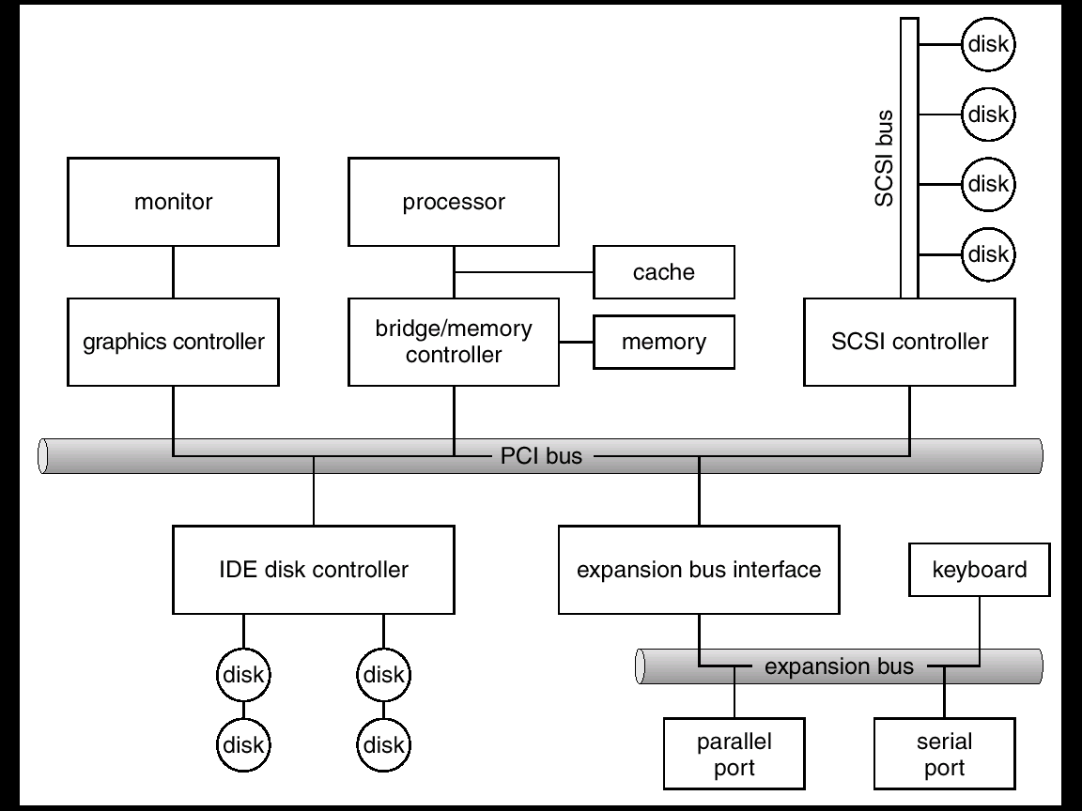
A Typical PC Bus Structure

Slide 7
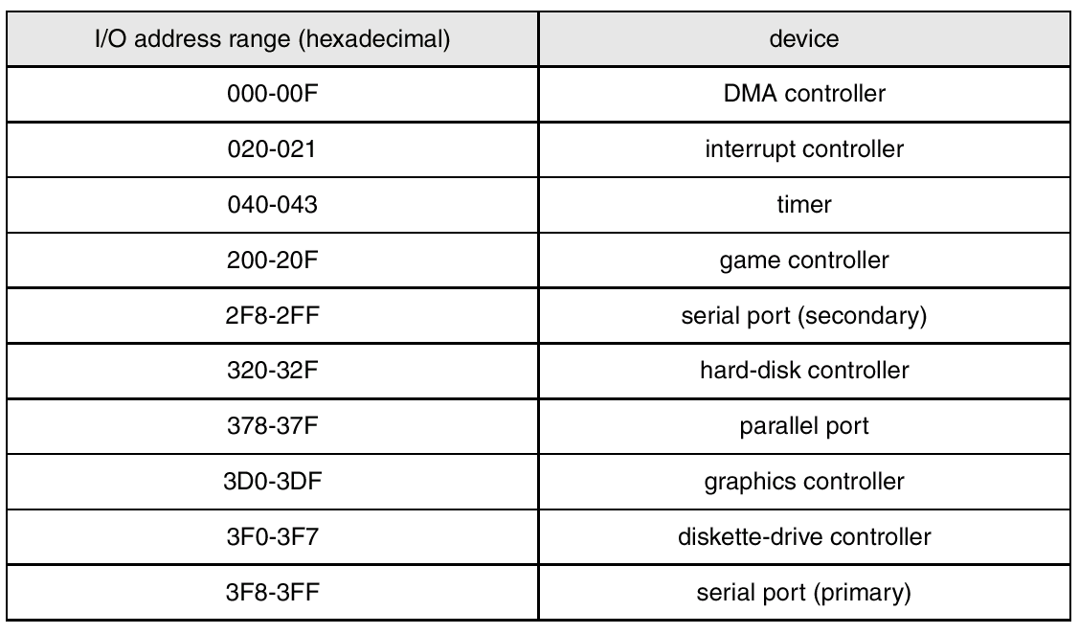
Device I/O Port Locations on PCs (partial)

Slide 8
Polling
Handshaking
Determines state of device
  2 bits are used to coordinate producer and consumer relationship.
  Controller sets the busy bit when it is working and clears when it is ready to accept the next command..
  command-ready
  busy
  Error
Busy-wait cycle to wait for I/O from device

Slide 9
Interrupts
CPU Interrupt request line triggered by I/O device
Interrupt handler receives interrupts
Maskable to ignore or delay some interrupts
Interrupt vector to dispatch interrupt to correct handler
  Based on priority
  Some unmaskable
Interrupt mechanism also used for exceptions

Slide 10
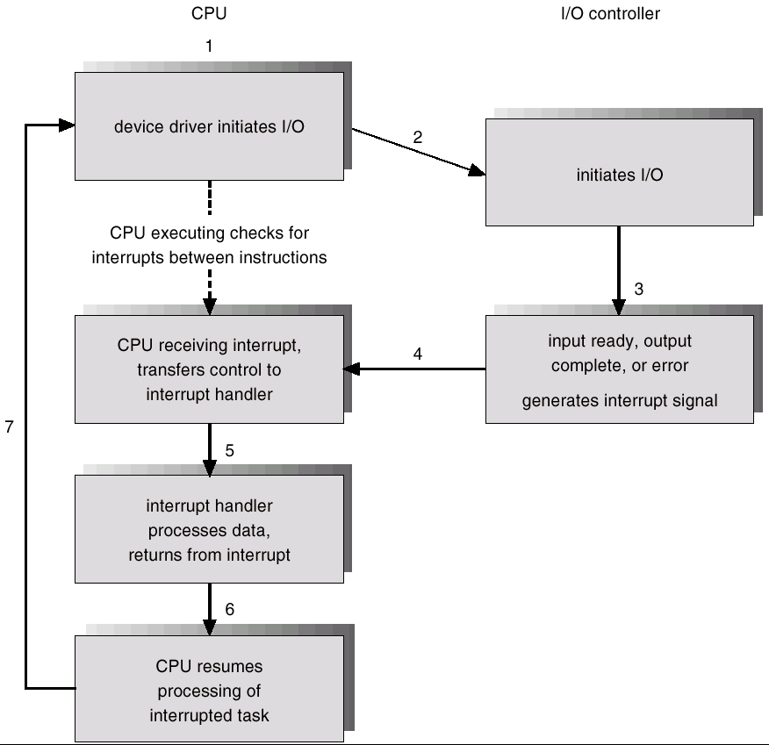
Interrupt-Driven I/O Cycle

Slide 11
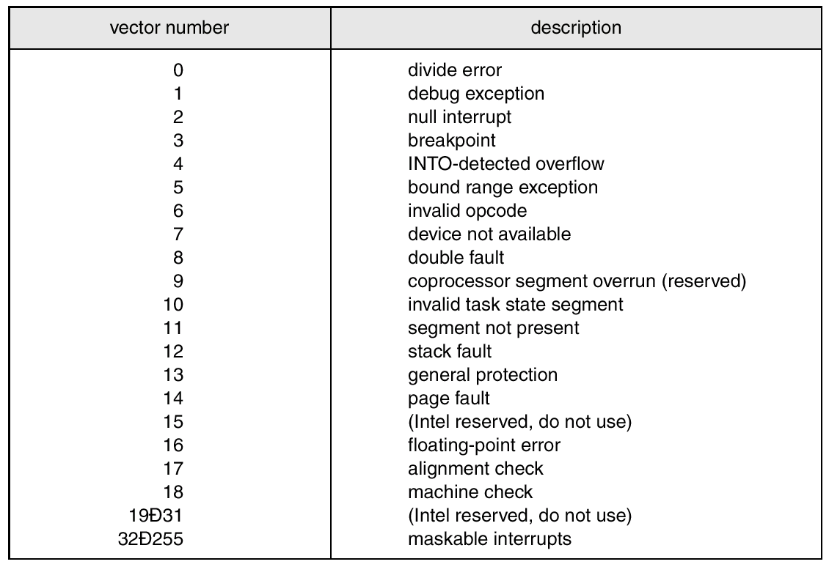
Intel Pentium Processor Event-Vector Table

Slide 12
Direct Memory Access
Used to avoid programmed I/O for large data movement
Requires DMA controller
Bypasses CPU to transfer data directly between I/O device and memory

Slide 13

Six Step Process to Perform DMA Transfer

Slide 14
Application I/O Interface
I/O system calls encapsulate device behaviors in generic classes
Device-driver layer hides differences among I/O controllers from kernel
Devices vary in many dimensions
  Character-stream or block
  Sequential or random-access
  Sharable or dedicated
  Speed of operation
  read-write, read only, or write only

Slide 15
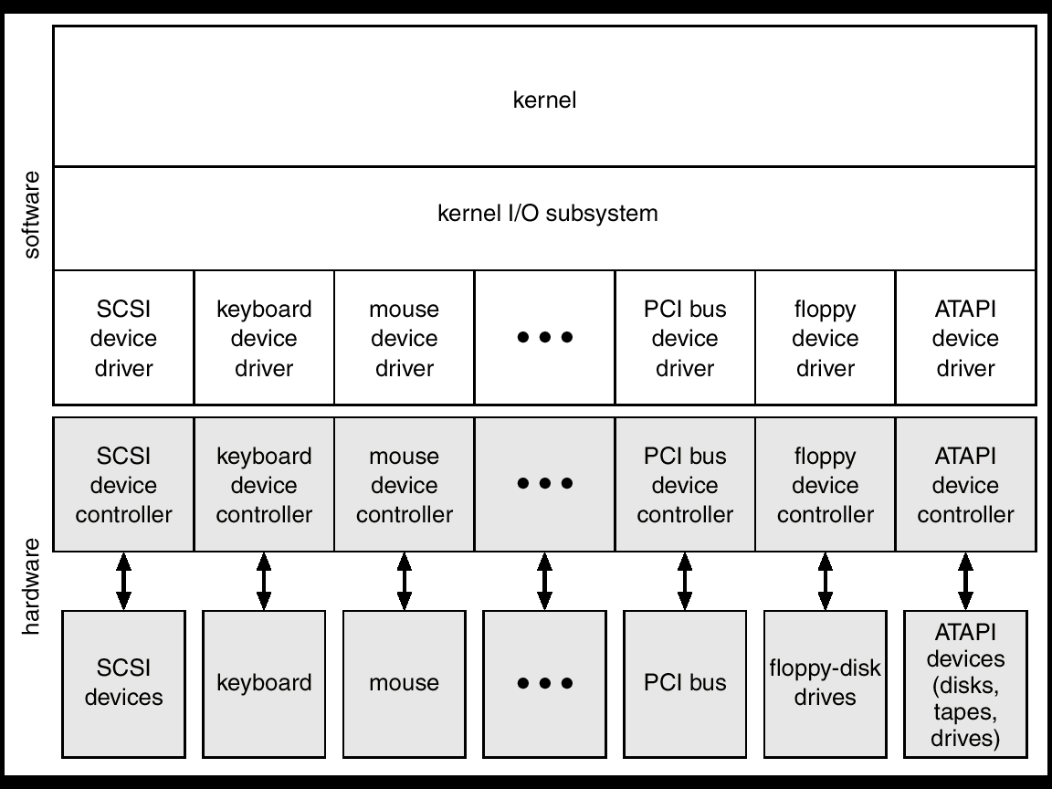
A Kernel I/O Structure

Slide 16
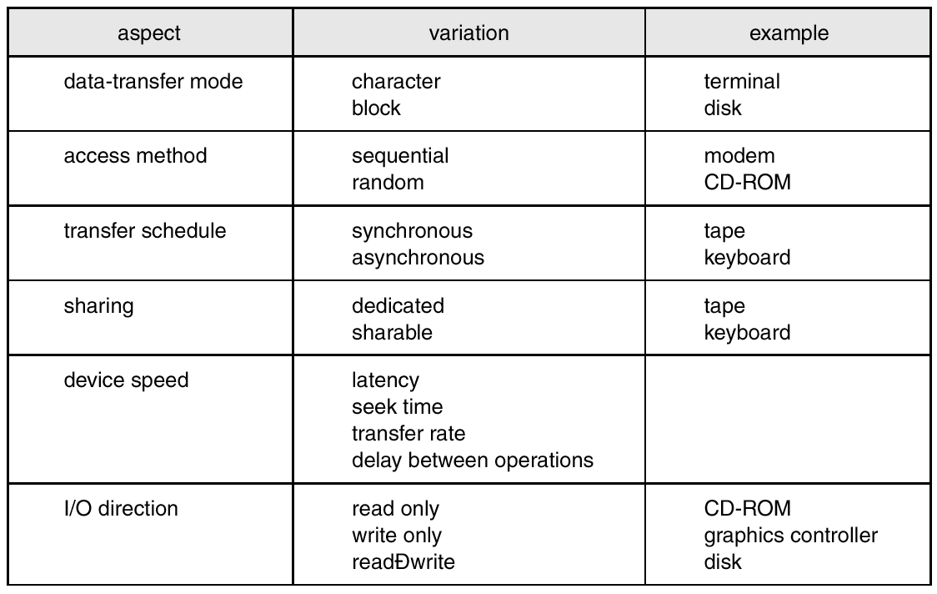
Characteristics of I/O Devices

Slide 17
Block and Character Devices
Block devices include disk drives
  Commands include read, write, seek
  Raw I/O or file-system access
  Memory-mapped file access possible
Character devices include keyboards, mice, serial ports
  Commands include get, put
  Libraries layered on top allow line editing

Slide 18
Network Devices
Varying enough from block and character to have own interface
Unix and Windows NT/9i/2000 include socket interface
  Separates network protocol from network operation
  Includes select functionality
Approaches vary widely (pipes, FIFOs, streams, queues, mailboxes)

Slide 19
Clocks and Timers
Provide current time, elapsed time, timer
If programmable interval time used for timings, periodic interrupts
ioctl (on UNIX) covers odd aspects of I/O such as clocks and timers

Slide 20
Blocking and Nonblocking I/O
Blocking - process suspended until I/O completed
  Easy to use and understand
  Insufficient for some needs
Nonblocking - I/O call returns as much as available
  User interface, data copy (buffered I/O)
  Implemented via multi-threading
  Returns quickly with count of bytes read or written
Asynchronous - process runs while I/O executes
  Difficult to use
  I/O subsystem signals process when I/O completed

Slide 21
Kernel I/O Subsystem
Scheduling
  Some I/O request ordering via per-device queue
  Some OSs try fairness
Buffering - store data in memory while transferring between devices
  To cope with device speed mismatch
  To cope with device transfer size mismatch
  To maintain “copy semantics”

Slide 22
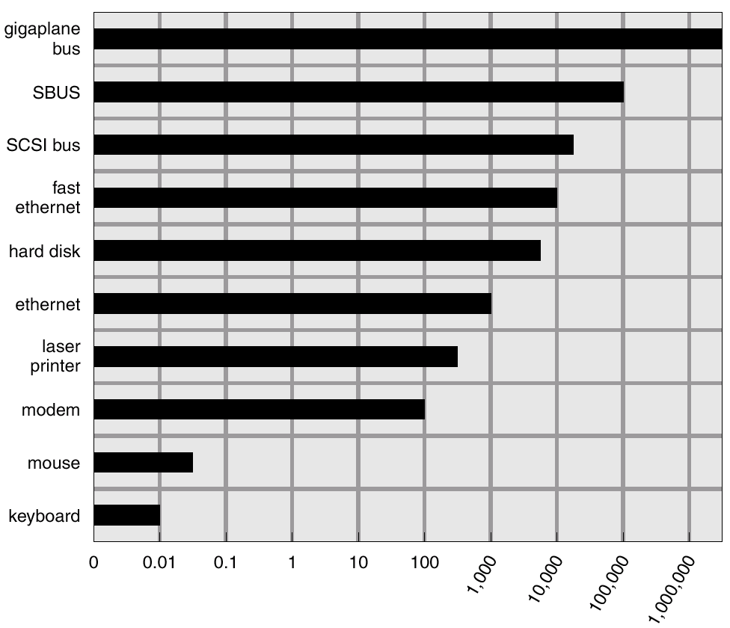
Sun Enterprise 6000 Device-Transfer Rates

Slide 23
Kernel I/O Subsystem
Caching - fast memory holding copy of data
  Always just a copy
  Key to performance
Spooling - hold output for a device
  If device can serve only one request at a time
  i.e., Printing
Device reservation - provides exclusive access to a device
  System calls for allocation and deallocation
  Watch out for deadlock

Slide 24
Error Handling
OS can recover from disk read, device unavailable, transient write failures
Most return an error number or code when I/O request fails
System error logs hold problem reports

Slide 25
Kernel Data Structures
Kernel keeps state info for I/O components, including open file tables, network connections, character device state
Many, many complex data structures to track buffers, memory allocation, “dirty” blocks
Some use object-oriented methods and message passing to implement I/O

Slide 26
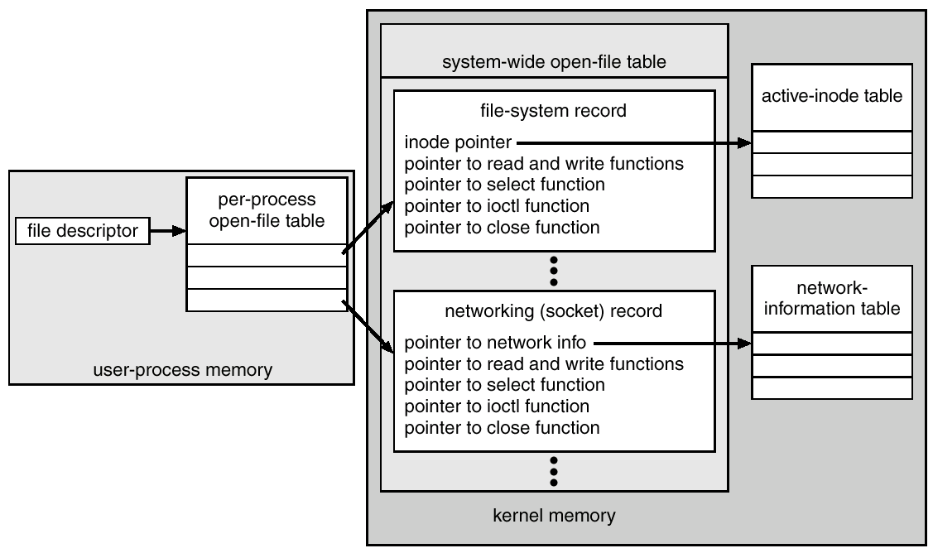
UNIX I/O Kernel Structure

Slide 27
I/O Requests to Hardware Operations
Consider reading a file from disk for a process:
  Determine device holding file
  Translate name to device representation
  Physically read data from disk into buffer
  Make data available to requesting process
  Return control to process

Slide 28
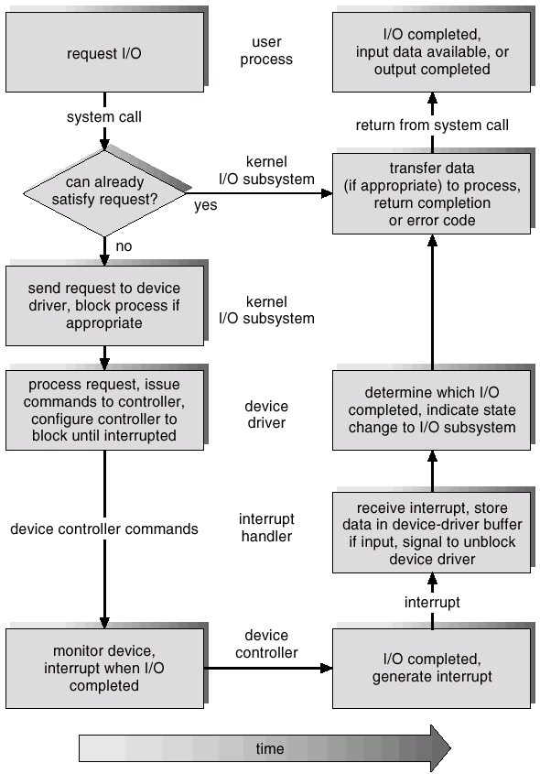
Life Cycle of An I/O Request

Slide 29
STREAMS
STREAM – a full-duplex communication channel between a user-level process and a device
A STREAM consists of:
- STREAM head interfaces with the user process
- driver end interfaces with the device
- zero or more STREAM modules between them.
Each module contains a read queue and a write queue
Message passing is used to communicate between queues

Slide 30
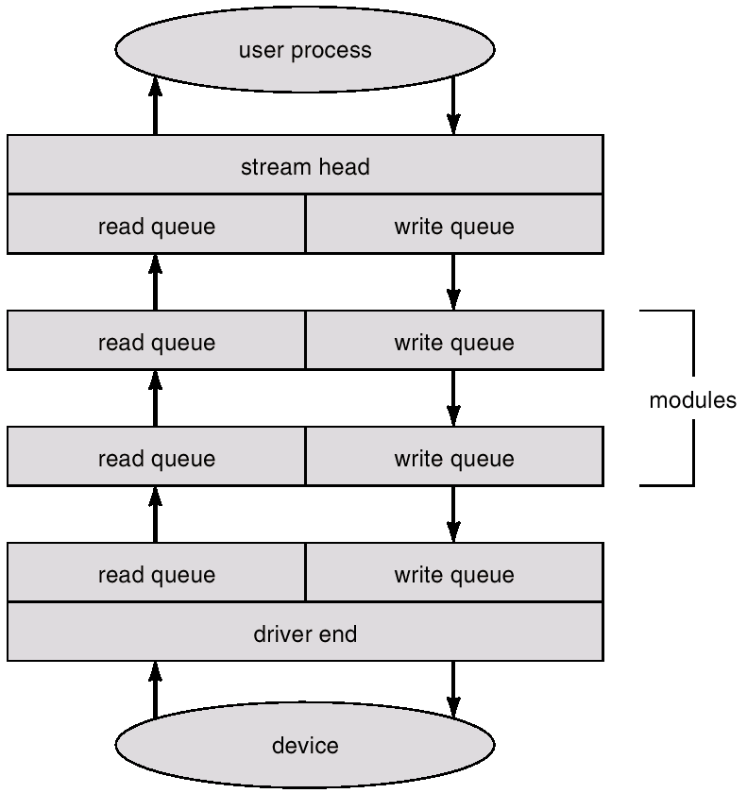
The STREAMS Structure

Slide 31
Performance
I/O a major factor in system performance:
  Demands CPU to execute device driver, kernel I/O code
  Context switches due to interrupts
  Data copying
  Network traffic especially stressful

Slide 32
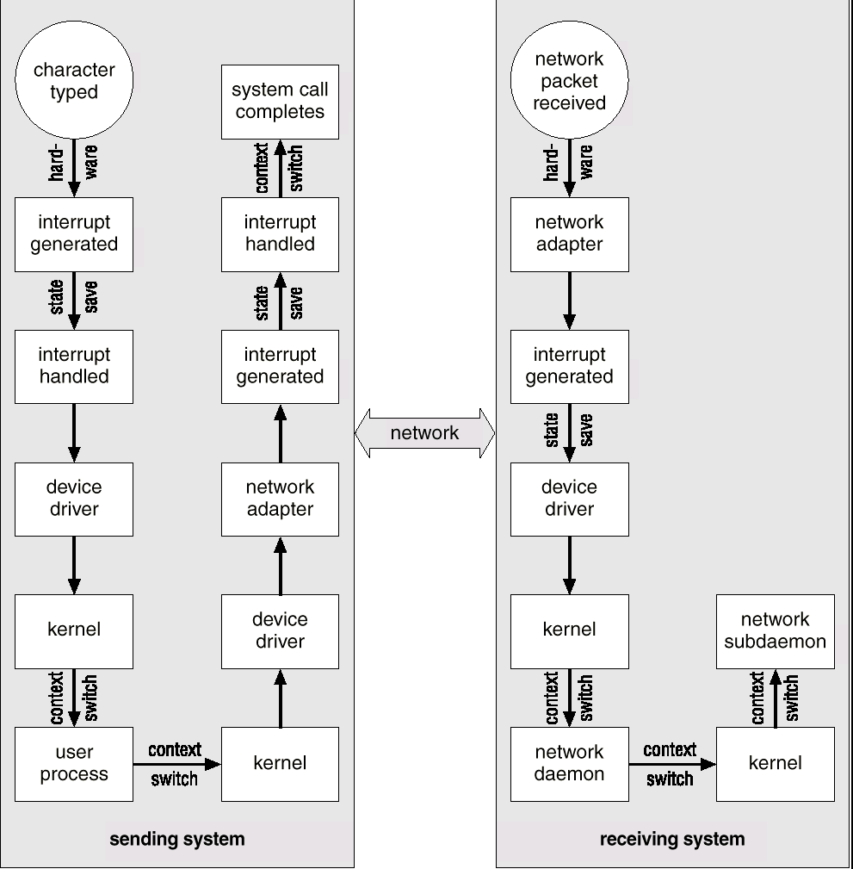
Intercomputer Communications

Slide 33
Improving Performance
Reduce number of context switches
Reduce data copying
Reduce interrupts by using large transfers, smart controllers, polling
Use DMA
Balance CPU, memory, bus, and I/O performance for highest throughput

Slide 34
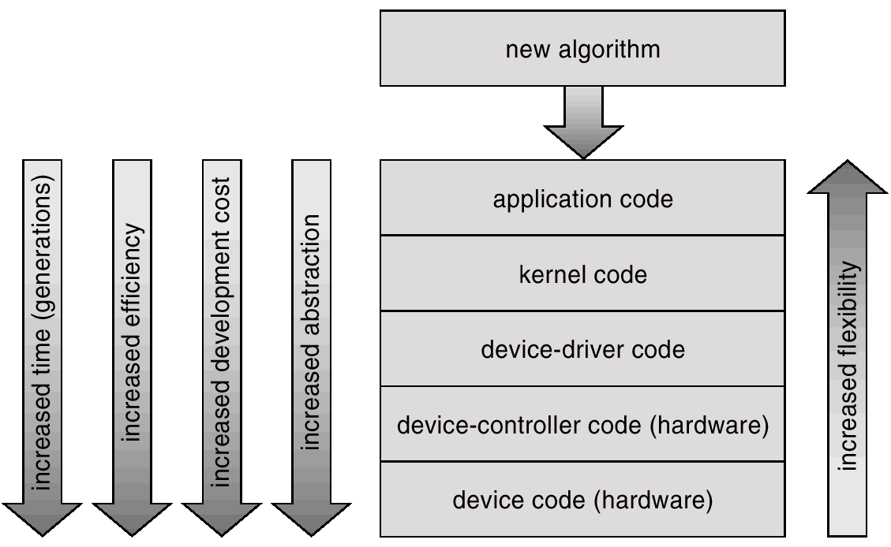
Device-Functionality Progression

